Slide 1
Session 14
String Class and Methods
Session Outcome
At the end of this session students will be able to understand Strings and use the methods in String class
KLEF OOPS BES-1

Slide 2
Session Content
String Class
Difference between String and StringBuffer
Methods of creating Strings
Difference in memory for Strings
String Handling Methods
String method based Program
Sorting of names using Java Program

Slide 3
String Class
String is a group of characters. They are objects of type String.
Once a String object is created it cannot be changed.
Strings are Immutable.
To get changeable strings use the class called StringBuffer.
String and StringBuffer classes are declared as final, so there cannot be subclasses of these classes.
The default constructor creates an empty string.
String s = new String( );

Slide 4
Difference between String and StringBuffer
StringBuffer class is mutable. A character is easily inserted into StringBuffer.
String is slow and consumes more memory when you concat too many strings because every time it creates new instance.
StringBuffer is fast and consumes less memory when you concat strings.
String class overrides the equals( ) method of Object class. So you can compare the contents of two strings by equals() method.
StringBuffer class doesn't override the equals() method of Object class.

Slide 5
Methods to Create String
Method 1:
To Create a String in JAVA is
String str = "abc";
Method 2:
char data[] = {'a', 'b', 'c'};
String str = new String(data);
If data array in the above example is modified after the string object str is created, then str remains unchanged.

Slide 6
Methods to Create String
Method 3:
Construct a string object by passing another string object.
String str2 = new String(str);

Slide 7
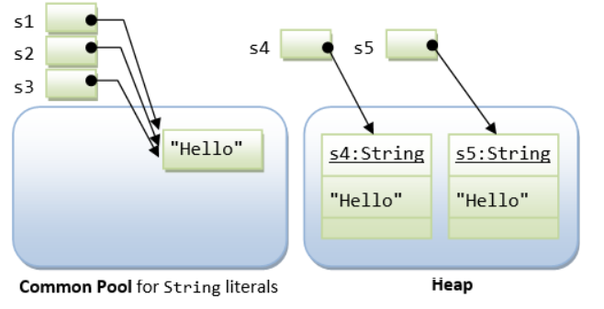
Difference in memory for String
String s1 = "Hello"; // String literal
String s2 = "Hello"; // String literal
String s3 = s1; // same reference
String s4 = new String("Hello"); // String object
String s5 = new String("Hello"); // String object

Slide 8
String Concatenation
+ operator
The + operator is used to concatenate two or more strings.
String myName = "Varun";
String s = "My name is" + myName+ ".";
Java compiler converts an operand to a String whenever the other operand of the + is a String object.
String myAge = “My age is";
String s = myAge + 24;

Slide 9
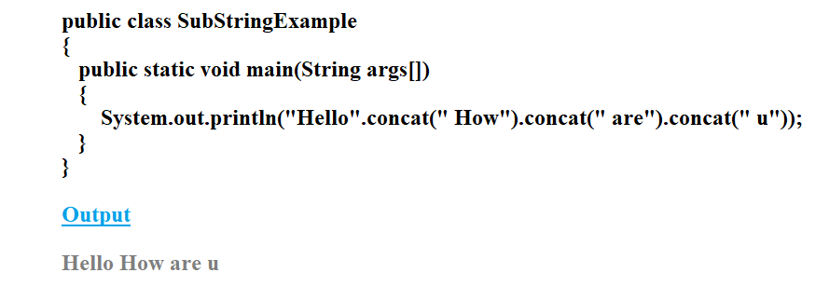
String Concatenation
Concat( ) method
This method concatenates one string to the end of another string.
public String concat(String anostr);

Slide 10
String Length and Character At
length( )
The length( ) method returns the length of the string.
System.out.println("Varun".length( ));
output: 5
charAt( )
Method returns the character at the specified index. An index ranges from 0 to length() - 1.
char c;
c = "abc".charAt(1);
// c = “b”

Slide 11
String Equals Method
equals( )
The equals( ) method returns true if the invoking object character sequence is same as argument object.
Provided both the objects are not null.
Otherwise, returns false.
public boolean equals(Object anObject);
String myStr1 = "Hello";
String myStr2 = "Hello";
String myStr3 = "Another String";

Slide 12
String Equals Method
equals( )
System.out.println(myStr1.equals(myStr2));
Output: true
System.out.println(myStr1.equals(myStr3));
Output: false

Slide 13
String Equals Method
equalsIgnoreCase( )
The equalsIgnoreCase ( ) method returns true if the invoking object character sequence is same as argument object.
Provided both the objects are not null.
Otherwise, returns false.
public boolean equalsIgnoreCase(Object anObject);
String myStr1 = “hello";
String myStr2 = "Hello";
String myStr3 = "Another String";

Slide 14
String Equals Method
equalsIgnoreCase( )
System.out.println(myStr1.equalsIgnoreCase(myStr2));
Output: true
System.out.println(myStr1.equalsIgnoreCase(myStr3));
Output: false

Slide 15
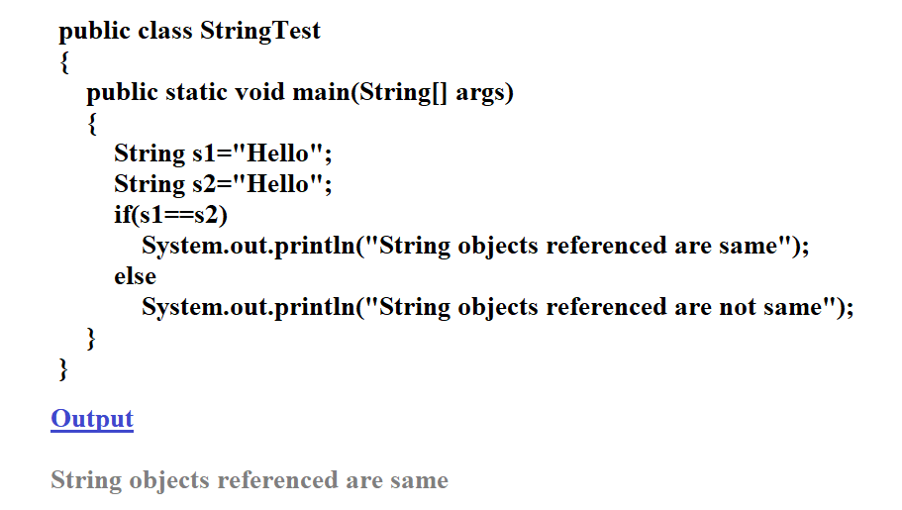
Comparing Strings using == operator

Slide 16
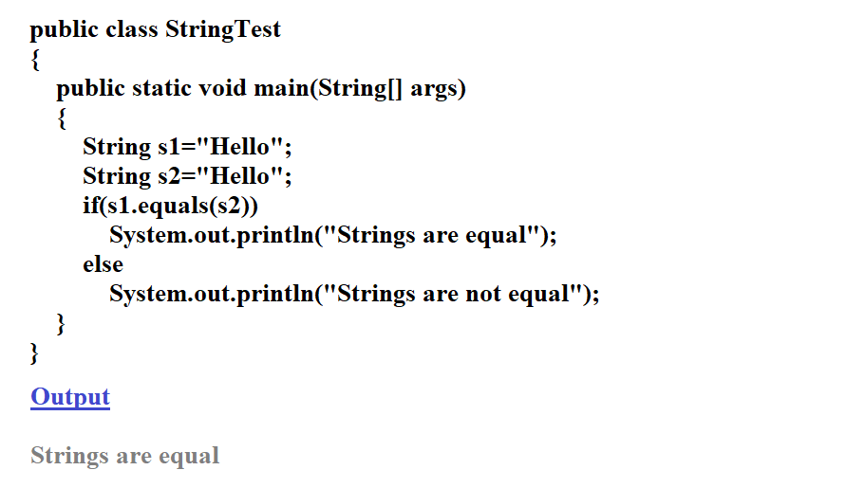
Comparing Strings using equals method

Slide 17
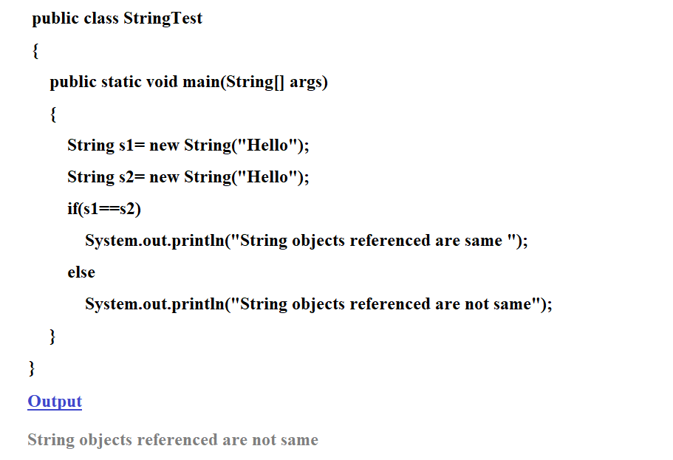
Comparing Strings using == operator

Slide 18
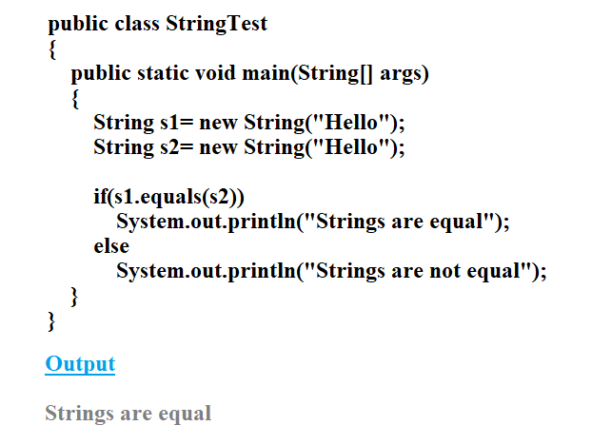
Comparing Strings using equals method

Slide 19
Prefix and Suffix Method
startsWith( )
Tests if this string starts with the specified prefix.
public boolean startsWith(String prefix)
System.out.println("January".startsWith("Jan"));
Output : true
endsWith( )
Tests if this string ends with the specified suffix.
public boolean endsWith(String prefix)
System.out.println("January".endsWith(“ry"));
Output : true

Slide 20
Comparing Strings
compareTo( )
Compares two strings and to know which string is bigger or smaller.
– We will get a negative integer, if this String object is less than the argument string.
– We will get a positive integer if this String object is greater than the argument string.
– We will get a return value 0 (zero), if these strings are equal.
public int compareTo(String anotherString)
public int compareToIgnoreCase(String str)

Slide 21
Indexof Method
indexOf( )
Searches for the first occurrence of a character or substring. Returns -1 if the character does not occur.
Method 1
public int indexOf(int ch)
It searches for the character represented by ch within this string and returns the index of first occurrence of this character.

Slide 22
Indexof Method
Method 2
public int indexOf(String str)
It searches for the substring specified by str within this string and returns the index of first occurrence of this substring.
Method 3
public int indexOf(int ch, int fromIndex)
It searches for the character represented by ch within this string and returns the index of first occurrence of this character starting from the position specified by fromIndex.

Slide 23
Indexof Method
Method 4
public int indexOf(String str, int fromIndex)
Returns the index within this string of the first occurrence of the specified substring, starting at the specified index.

Slide 24
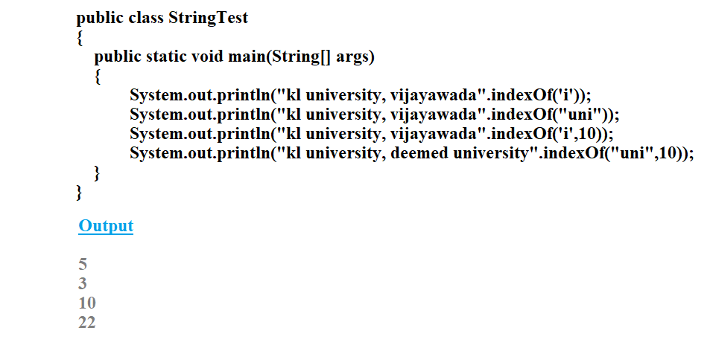
Indexof Method Example

Slide 25
lastIndexof Method
lastIndexOf( )
This method returns the position of the last occurrence of specified character(s) in a string.
public int lastIndexOf(String str)
public int lastIndexOf(String str, int fromIndex)
public int lastIndexOf(int char)
public int lastIndexOf(int char, int fromIndex)
fromIndex - An int value, representing the index position to start the search from. If omitted, the default value is the length of the string.

Slide 26
substring Method
substring( )
This method returns a new string that is a substring of the string.
Method-1
public String substring(int begIndex)
The substring begins with the character at the specified index and extends to the end of this string.
Method-2
public String substring(int begIndex, int endIndex)
The substring begins with the character at the specified index and extends to the end of this string or up to endIndex – 1, if the second argument is given.

Slide 27
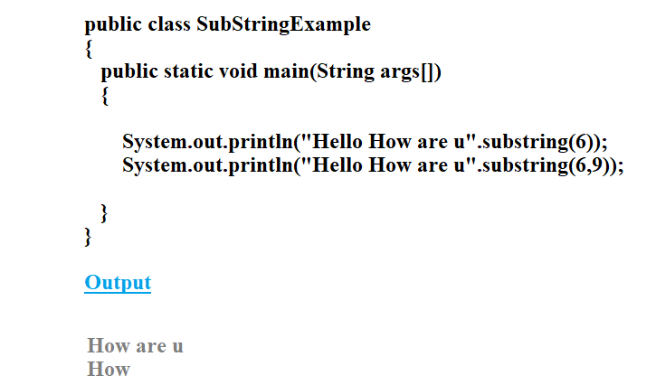
substring Method

Slide 28
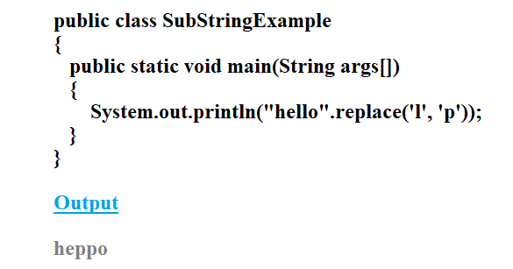
replace Method
replace( )
This method searches a string for a specified character, and returns a new string with the replaced character.
public String replace(char searchChar, char newChar)

Slide 29
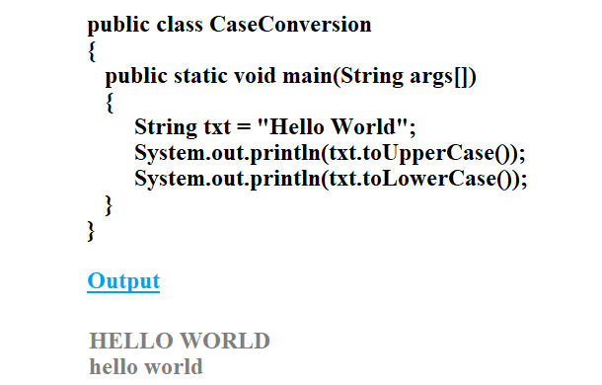
String Case Conversion Method
toLowerCase( )
Method converts all of the characters in a String to lower case.
toUpperCase( )
Method converts all of the characters in a String to upper case.

Slide 30
String Conversion Method
valueOf( )
This method returns the string representation of the passed argument.
public static String valueOf(boolean b)
public static String valueOf(char c)
public static String valueOf(char[] data)
public static String valueOf(double d)
public static String valueOf(float f)
public static String valueOf(int i)

Slide 31
String Conversion Method
valueOf( )
public static String valueOf(long l)
public static String valueOf(Object obj)
public static String valueOf(char[] data, int offset, int
count)

Slide 32
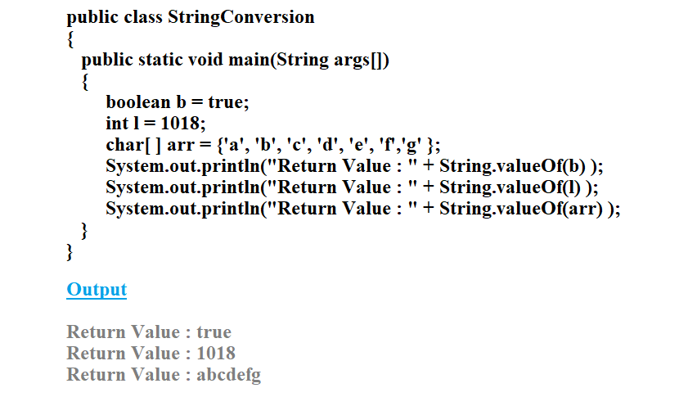
String Conversion Method

Slide 33
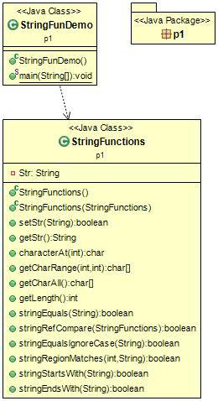
Program-1
Write a program to implement the following.
charAt( )
getChars( )
toCharArray( )
length( )
equals( )
== operator
equalsIgnoreCase( )
regionMatches( )
startsWith( )
endsWith( )

Slide 34
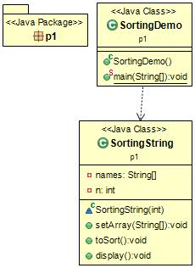
Program-2
Write a program to read names from the keyboard and sort the names in ascending order using compareTo( ).

Slide 35
THANK
YOU

